Slide 1
Analyzing Blood Donation probabilities and number of possible donors
SIDHARTH K
MES20MCA-2049
PRODUCT OWNER-FEBIN AZIZ

Slide 2
TABLE OF CONTENTS
Introduction
Modules
Methodology
Future Enhancement
Project Plan
User Story
Product Backlog
Sprint Plan
Sprint Actual

Slide 3
INTRODUCTION
Blood transfusion has critical importance for human survival in risky situations that may occur. The number of possible donors and blood donation probabilities can be determined by using machine learning approaches. When the need for blood occurs in the future, medical professionals can predict potential donors for blood donation. Machine learning algorithms can support the blood transfusion process using datasets. When it comes to human health, data analysis is carried out to help prevent situations that will have critical consequences. By looking at the results of the data analysis, donors who may donate blood can be detected. In order to make this process carried out as expected, accurate and complete access to existing records must be provided. Blood transfusion has been provided for many years.

Slide 4
MODULES
USERS
Registration
Login
View blood requirements
Accept blood request
Donate
Search blood
BLOOD BANK
Login
Add blood requirements
View request status
Update donation information
Probability check

Slide 5
METHODOLOGY
In this Project the aim is to donate blood by users and also by theA blood bank system . The blood bank can also request for blood and also check the probability of getting the blood by using the history of a donor by their previous history.
At the user side user can also donate the blood , accept the blood , view donation status also.

Slide 6
DEVELOPING ENVIRONMENT
Software Requirements
OPERATING SYSTEM : WINDOWS Platform
FRONT END : HTML, CSS, JAVASCRIPT
BACK END : Mysql
IDE USED : Jetbrains Pycharm, Android studio
TECHNOLOGY USED : PYTHON JAVA
FRAME WORK USED : Flask
Hardware Requirements
Processor : Intel Pentium Core i3 and above, 64 bits
RAM : Min3GB RAM
HARD DISK: 10 GB

Slide 7
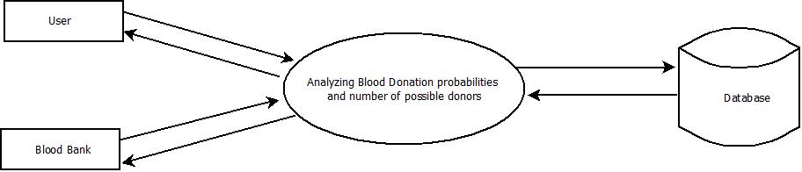
DATA FLOW DIAGRAM
Level 0
Request for Login
Response
Request data
Request for Login
Get data
Response

Slide 8
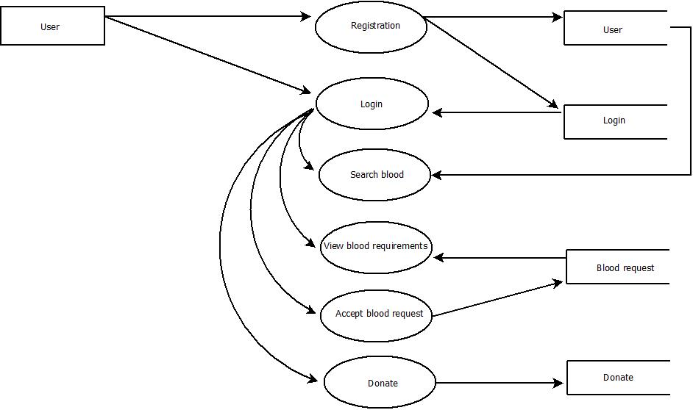
Level 1.1
Check for Registration
Request for Registration
Request for Login
Check for Login
Response
Information exchange
Information exchange
Display Package
Information exchange
Display Package
Information exchange
Request
Request

Slide 9
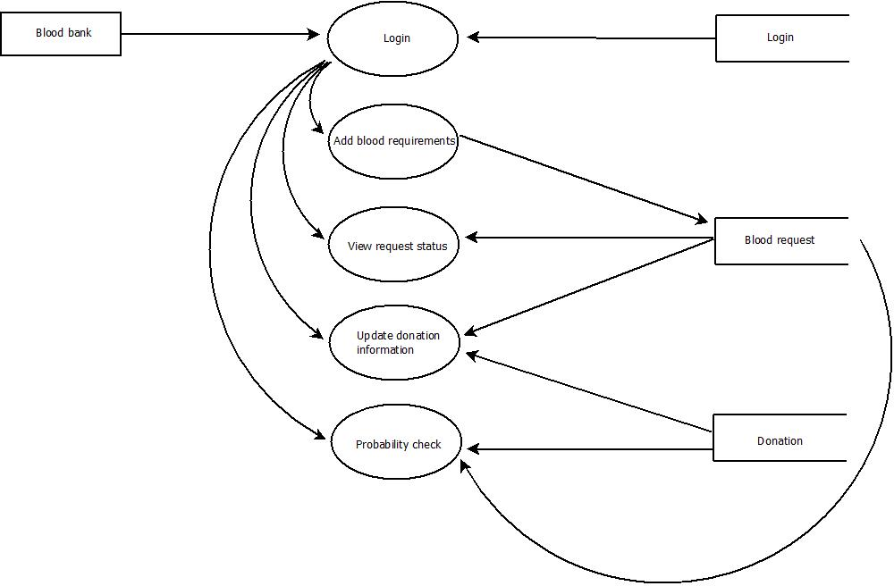
Level 1.2
Request for Login
Response
Information exchange
Information exchange
Response
Information exchange
Response
Request
Information exchange
Response
Response
Response

Slide 10
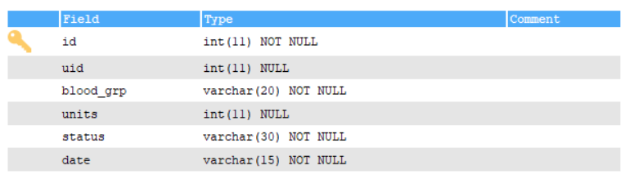
TABLE DESIGN
Blood Donation

Slide 11
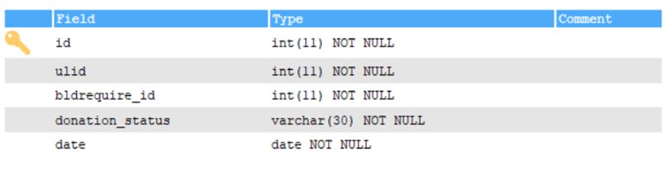
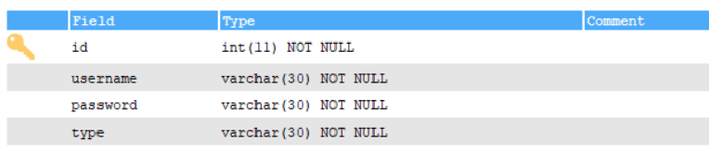
Donation
Login

Slide 12
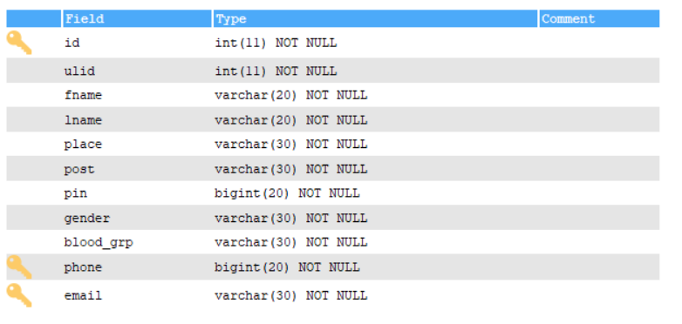
User

Slide 13
FUTURE ENHANCEMENTS
LOCATION BASED SERVICES
Location-based services (LBS) refers to services that are based on the location of a mobile user as determined by the device's geographical location. LBS applications provide services and information that are most relevant to the user at that location. So the user can easily find the donor in the near location .

Slide 14
PROJECT PLAN
User Story ID | Task Name | Start Date | End Date | Days | Status
1 | Sprint 1 | 30/11/2021 | 04/12/2021 | 5 | Completed
2 |  | 16/12/2021 | 20/12/2021 | 5 | Completed
3 |  | 24/12/2021 | 27/12/2021 | 4 | Completed
4 | Sprint 2 | 09/01/2022 | 16/01/2022 | 7 | Completed
5 |  | 18/01/2022 | 22/01/2022 | 4 | Completed
6 | Sprint 3 | 23/01/2022 | 27/01/2022 | 5 | Completed
7 |  | 28/01/2022 | 31/01/2022 | 4 | Completed
8 | Sprint 4 | 01/02/2022 | 03/02/2022 | 3 | Completed
9 |  | 06/02/2022 | 09/02/2022 | 4 | Completed
10 |  | 11/02/2022 | 14/02/2022 | 4 | Completed
11 |  | 15/02/2022 | 19/02/2022 | 5 | Completed

Slide 15
USER STORY
User Story ID | As a <type of user> | I want to | So that I can
1 | Blood Bank | login | login successful with correct username and password
2 | Blood Bank | Add blood requirement | Add request for required blood group
3 | Blood Bank | View request status | View blood requirement request status
4 | Blood Bank | Update donation | information Update request status to donation
5 | Blood Bank | Probability check | Checking probability of blood availability
6 | User | Registration | Register user by details
7 | User | Login | Login by using username and password
8 | User | Search blood | Search blood by group
9 | User | View blood requirements | View same blood group requirements
10 | User | Accept request | Accept blood request
11 | User | Donate | Donate blood

Slide 16
PRODUCT BACKLOG
User Story ID | Priority <High/Medium/Low> | Size (Hours) | Sprint <#> | Status <Planned/In progress/Completed> | Release Date | Release Goal
1 | Medium | 2 | 1 | Completed | 04/12/2021 | Table design
2 | High | 3 |  | Completed | 20/12/2021 | Form design
3 | High | 5 |  | Completed | 27/12/2021 | Basic coding
4 | High | 5 | 2 | Completed | 16/01/2022 | Information Update request status to donation
5 | Medium | 5 |  | Completed | 22/01/2022 | Checking probability of blood availability
6 | High | 5 | 3 | Completed | 27/01/2022 | Register user by details
7 | Medium | 5 |  | Completed | 31/01/2022 | Login by using username and password
8 | Medium | 5 |  | Completed | 03/02/2022 | Search blood by group
9 | High | 5 | 4 | Completed | 09/02/2022 | View same blood group requirements
10 | Medium | 5 |  | Completed | 14/02/2022 | Accept blood request
11 | Medium | 5 |  | Completed | 19/02/2022 | Output Generation

Slide 17
SPRINT BACKLOG PLAN
Backlog Item | Status & completion date | Original estimate in hours | Day1 | Day2 | Day3 | Day4 | Day5 | Day6 | Day7 | Day8 | Day9 | Day10 | Day11 | Day12 | Day13 | Day14
User story #1,#2,#3 |  | hrs | hrs | hrs | hrs | hrs | hrs | hrs | hrs | hrs | hrs | hrs | hrs | hrs | hrs | hrs
Table design | 04/12/2021 | 2 | 1 | 0 | 1 | 0 | 0 | 0 | 0 | 0 | 0 | 0 | 0 | 0 | 0 | 0
Form design | 20/12/2021 | 3 | 0 | 1 | 0 | 1 | 1 | 0 | 0 | 0 | 0 | 0 | 0 | 0 | 0 | 0
Basic coding | 27/12/2021 | 5 | 0 | 0 | 0 | 0 | 0 | 0 | 0 | 0 | 1 | 1 | 1 | 1 | 1 | 0
User story #4,#5
Information Update request status to donation | 16/01/2022 | 5 | 1 | 1 | 1 | 0 | 0 | 1 | 1 | 0 | 0 | 0 | 0 | 0 | 0 | 0
Checking probability of blood availability | 22/01/2022 | 5 | 0 | 0 | 1 | 1 | 1 | 1 | 1 | 0 | 0 | 0 | 0 | 0 | 0 | 0

Slide 18
User story #6,#7,#8
Register user by details | 27/01/2022 | 5 | 1 | 1 | 1 | 1 | 1 | 0 | 0 | 0 | 0 | 0 | 0 | 0 | 0 | 0
Login by using username and password | 31/01/2022 | 5 | 0 | 0 | 0 | 1 | 1 | 1 | 1 | 1 | 0 | 0 | 0 | 0 | 0 | 0
Search blood by group | 03/02/2022 | 5 | 1 | 1 | 1 | 1 | 1 | 0 | 0 | 0 | 0 | 0 | 0 | 0 | 0 | 0
User story #9,#10,#11
View same blood group requirements | 10/02/2022 | 5 | 0 | 0 | 0 | 0 | 0 | 1 | 1 | 1 | 1 | 1 | 0 | 0 | 0 | 0
Accept blood request | 14/02/2022 | 5 | 1 | 1 | 1 | 1 | 1 | 0 | 0 | 0 | 0 | 0 | 0 | 0 | 0 | 0
Output Generation | 19/02/2022 | 5 | 1 | 1 | 1 | 1 | 1 | 0 | 0 | 0 | 0 | 0 | 0 | 0 | 0 | 0
Total |  | 50 | 6 | 6 | 7 | 7 | 7 | 4 | 4 | 2 | 2 | 2 | 1 | 1 | 1 | 0

Slide 19
SPRINT ACTUAL
Backlog Item | Status & completion date | Original estimate in hours | Day1 | Day2 | Day3 | Day4 | Day5 | Day6 | Day7 | Day8 | Day9 | Day10 | Day11 | Day12 | Day13 | Day14
User story #1,#2,#3 |  | hrs | hrs | hrs | hrs | hrs | hrs | hrs | hrs | hrs | hrs | hrs | hrs | hrs | hrs | hrs
Table design | 04/12/2021 | 2 | 1 | 0 | 1 | 0 | 0 | 0 | 0 | 0 | 0 | 0 | 0 | 0 | 0 | 0
Form design | 20/12/2021 | 3 | 0 | 1 | 0 | 1 | 1 | 0 | 0 | 0 | 0 | 0 | 0 | 0 | 0 | 0
Basic coding | 27/12/2021 | 5 | 0 | 0 | 0 | 0 | 0 | 0 | 0 | 0 | 1 | 1 | 1 | 1 | 1 | 0
User story #4,#5
Information Update request status to donation | 16/01/2022 | 5 | 1 | 1 | 1 | 0 | 0 | 1 | 1 | 0 | 0 | 0 | 0 | 0 | 0 | 0
Checking probability of blood availability | 22/01/2022 | 5 | 0 | 0 | 1 | 1 | 1 | 1 | 1 | 0 | 0 | 0 | 0 | 0 | 0 | 0

Slide 20
User story #6,#7,#8
Register user by details | 27/01/2022 | 5 | 1 | 1 | 1 | 1 | 1 | 0 | 0 | 0 | 0 | 0 | 0 | 0 | 0 | 0
Login by using username and password | 31/01/2022 | 5 | 0 | 0 | 0 | 1 | 1 | 1 | 1 | 1 | 0 | 0 | 0 | 0 | 0 | 0
Search blood by group | 03/02/2022 | 5 | 1 | 1 | 1 | 1 | 1 | 0 | 0 | 0 | 0 | 0 | 0 | 0 | 0 | 0
User story #9,#10,#11
View same blood group requirements | 10/02/2022 | 5 | 0 | 0 | 0 | 0 | 0 | 1 | 1 | 1 | 1 | 1 | 0 | 0 | 0 | 0
Accept blood request | 14/02/2022 | 5 | 1 | 1 | 1 | 1 | 1 | 0 | 0 | 0 | 0 | 0 | 0 | 0 | 0 | 0
Output Generation | 19/02/2022 | 5 | 1 | 1 | 1 | 1 | 1 | 0 | 0 | 0 | 0 | 0 | 0 | 0 | 0 | 0
Total |  | 50 | 6 | 6 | 7 | 7 | 7 | 4 | 4 | 2 | 2 | 2 | 1 | 1 | 1 | 0

Slide 21
THANK YOU

